Slide 1

Leonardo Da Vinci
Life and Times of Leonardo Da Vinci

Slide 2
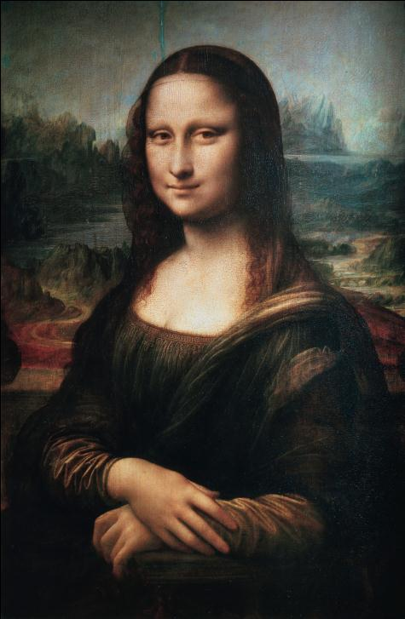
Outline
Introduction
Early Life in Florence
Years in Milan

Slide 3
Introduction
Life 1452 through 1519 (67 years)
Celebrated – Painter, Sculptor, architect, engineer, scientist
Work influenced Italian Art over 100 years
Work influences science & engineering to this day

Slide 4
Early Life in Florence
Born 1452 town of Vinci in Tuscany
Moved to Florence in the mid 1460’s where education began
Was a garzone to Andrea del Verrocchio (Leading Floretine painter & sculptor
  Studied painting, sculpting, bronze work
1478 became an independent master

Slide 5
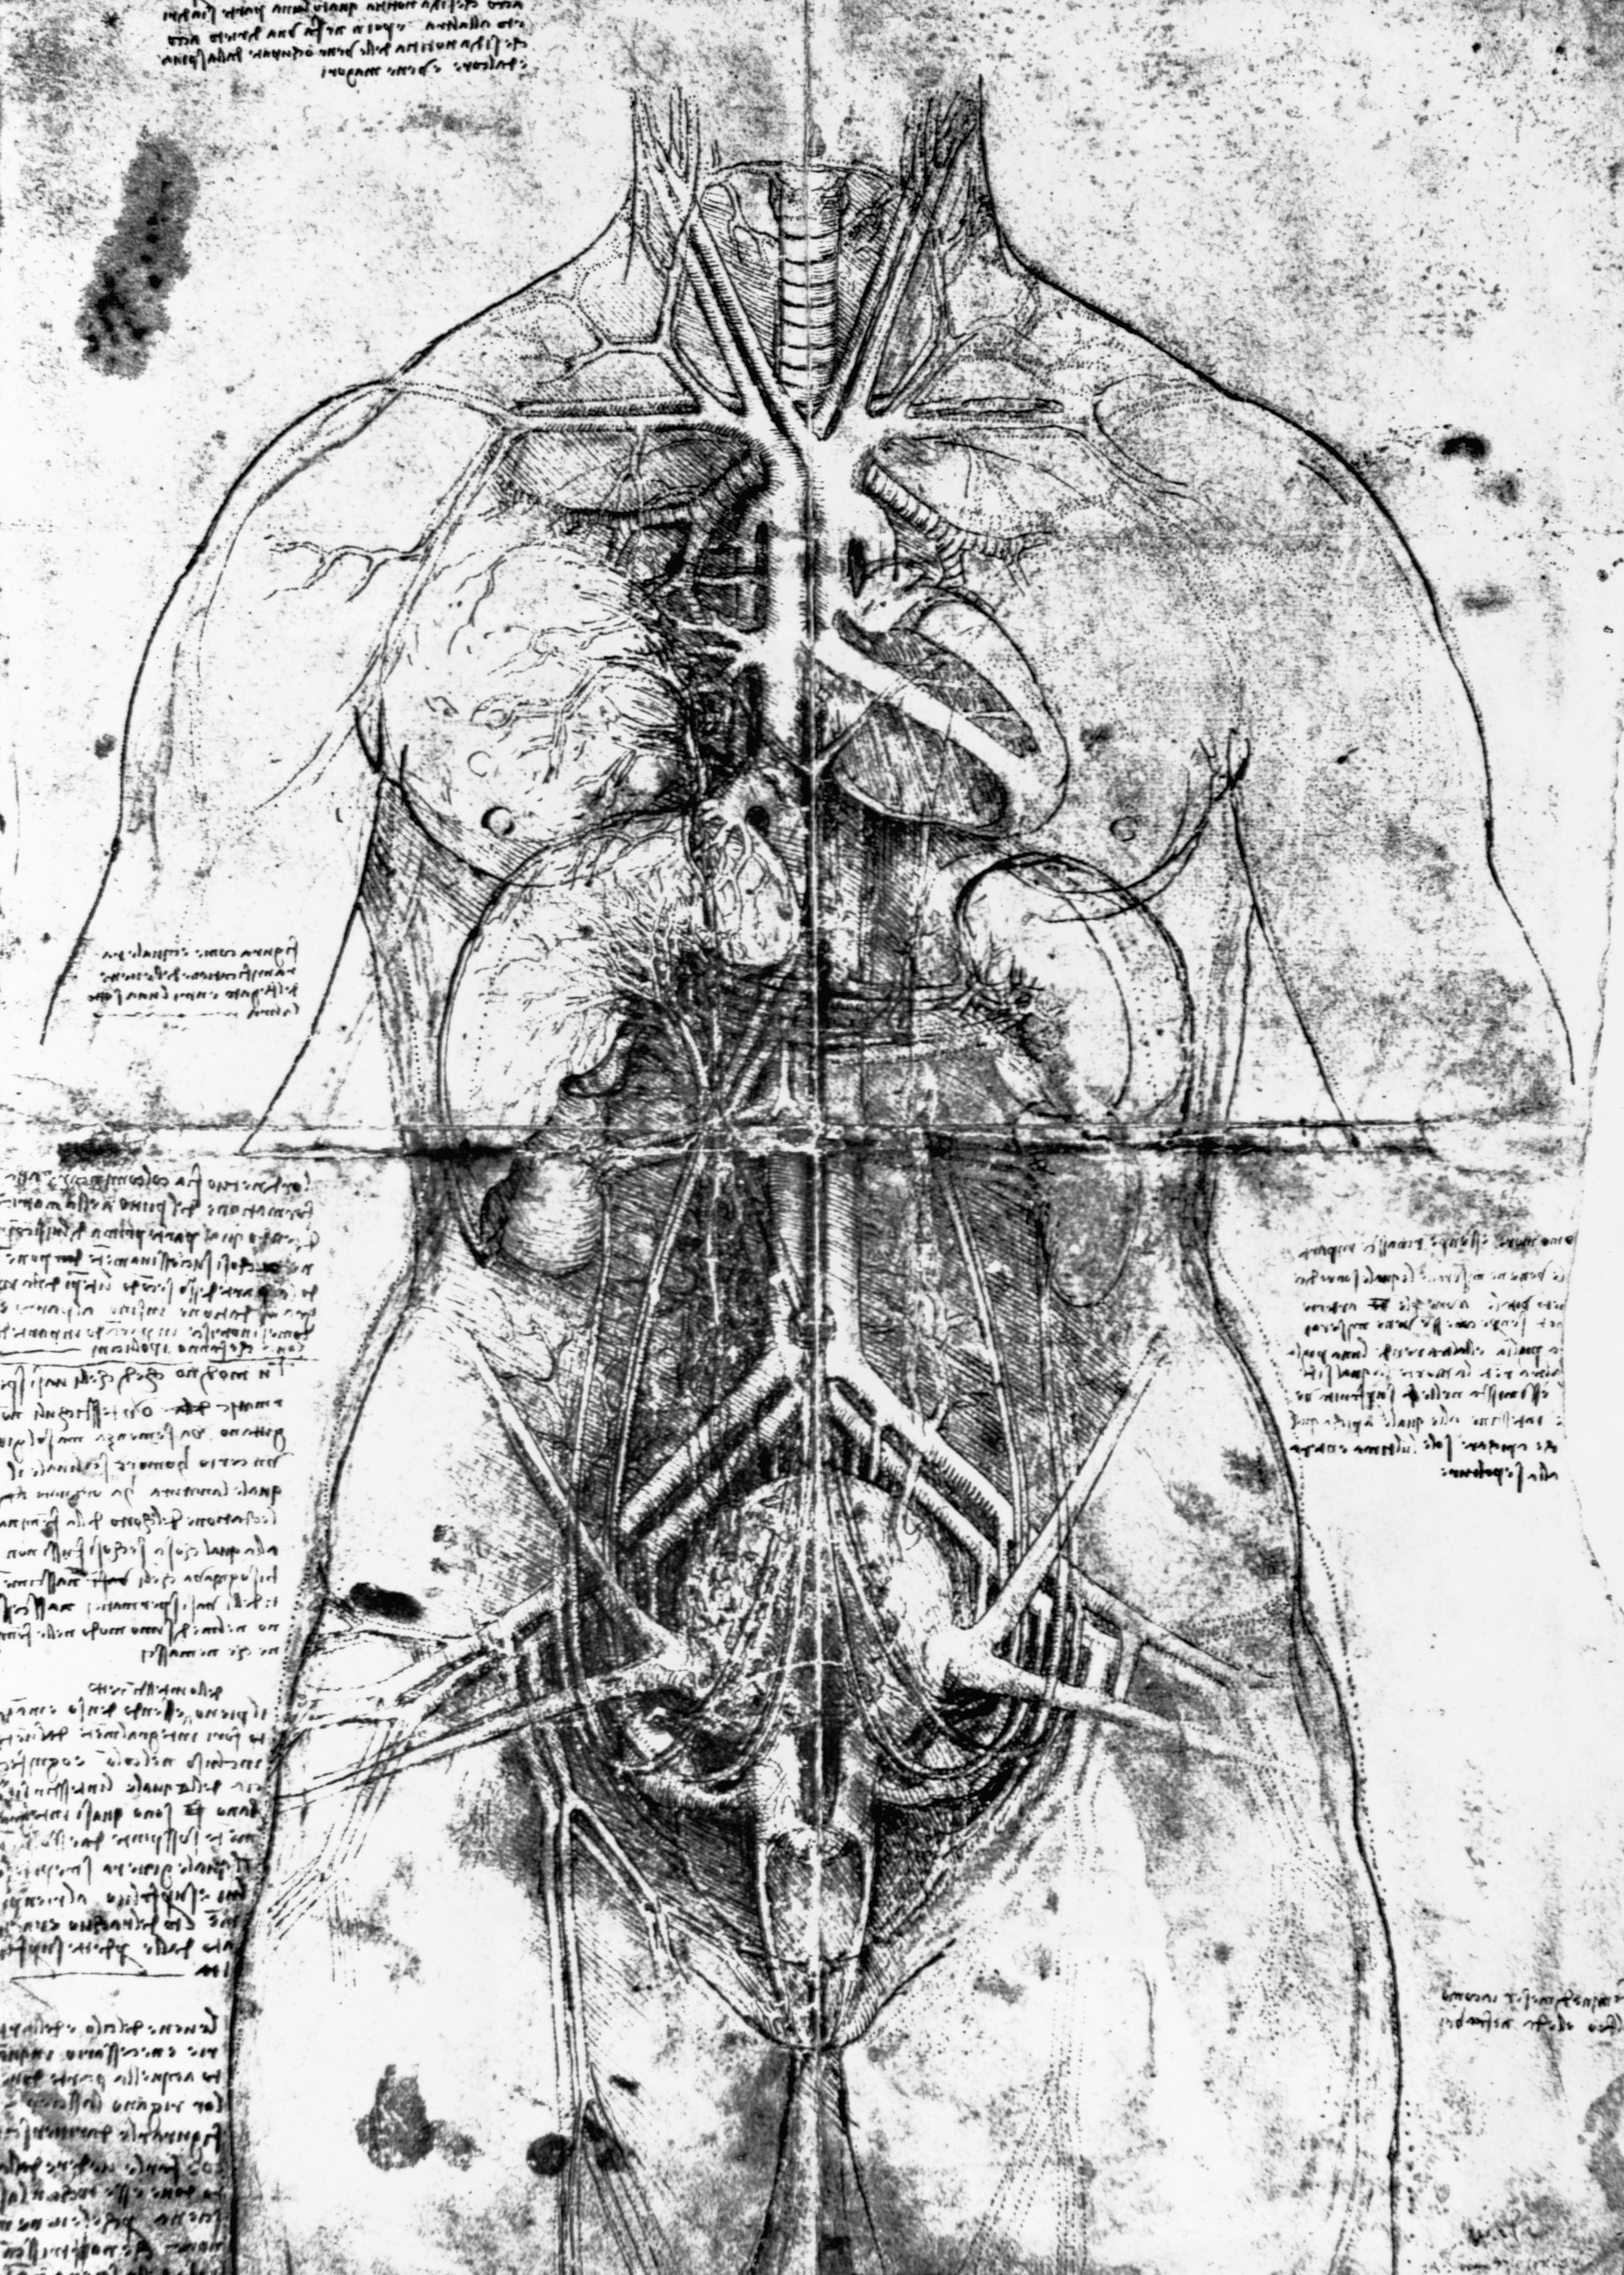
Years in Milan
1482 began working for the duke of Milan
  Stated he could build
    Portable bridges
    Cannons
    Build ships
    Armored vehicles
    Catapults
    Etc…
  Served as Principal engineer to the duke

Slide 6
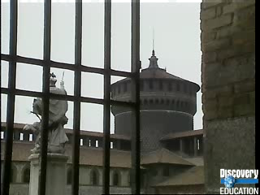
Leonardo in Milan

